Slide 1
SCSA1104- Problem Solving Technique with C and C++
By
Dr.T.Judgi,
Associate Professor,
Department of Computer Science and Engineering
Sathyabama Institute of Science and Technology

Slide 2
Overview
Syllabus SCSA1104 - PST C and C++ sylabus, lab.docx
Basic concepts of computer
- Hardware and Software
- Basic computer equipment
Advantages and Disadvantages
Application of Computer ITNBA
Programming Languages
Problem Solving Technique

Slide 3
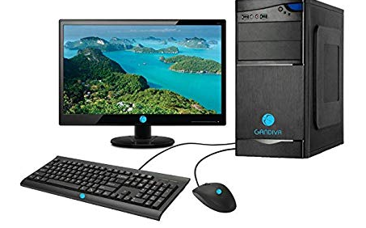
Basic concepts of computer
Computer
A computer is a programmable electronic device that accepts
raw data as input and process it with a set of instructions to
produce the result as output.
Basic terms
Data – collection of facts or pictures
Input – data sent to a computer
Processing – performing operations on the data
Output – displaying the result
Instructions - order given to a computer processor
Information - processed data
Input
Process
Output

Slide 4
Instruction
Forward 100
Right 90
Forward 100
Right 90
Forward 100
Right 90
Forward 100
Forward 100
Right 90
Right 90
Forward 100
Forward 100
Forward 100
Right 90

Slide 5
Characteristics of a computer
Speed - high speed electronic device
Automatic - work without any intervention of user
Accuracy - display accurate result
Storage - store large amount of data
No feelings - execute based on instructions
Consistency - repeat consistently

Slide 6
Hardware and software
Computer is made up of two components
1. Hardware
2. software
Hardware
It is any part of your computer that has a physical structure.
Example :
Keyboard, Mouse, Monitor, etc.,
Hardware consists of two components,
1. Input device – give information
2. Output device – display information

Slide 7
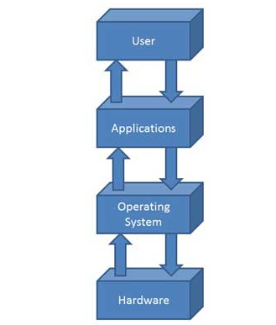
Hardware and software
Software
Software is any set of instructions that tells the hardware what to do and
helps the user accomplish a certain task.
Example :
Web browser, games, word processor, etc.,
Software can be categorized into two,
1. System software – set of programs that runs on a computer
- Operating System
2. Application software – set of programs to solve a particular problem
- Word, Excel, Oracle, PowerPoint

Slide 8
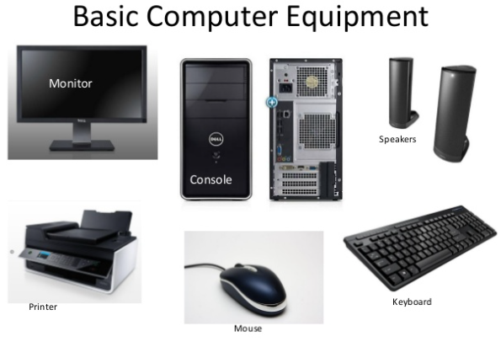
Main parts of the computer
Monitor
Console (System unit)
- Mother board
- Central Processing Unit (CPU)
- Random Access Memory(RAM)
Keyboard
- Numbers, Alphabet letters , Symbol.
Mouse
-Left Click, Right Click, Double Click, Drag and Drop
Printer
- Reproduce the text
Speaker

Slide 9
How computer memory is measured
Bit (Binary digit) – 0’s or 1’s
Byte
1 byte = 8 bits
Kilobyte (kb)
1kb = 1024 bytes
Megabyte (mb)
1mb = 1024 kb
Gigabyte (gb)
1gb = 1024 mb

Slide 10
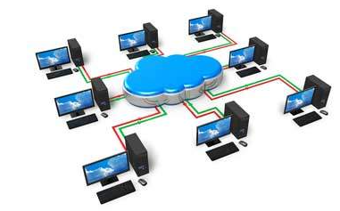
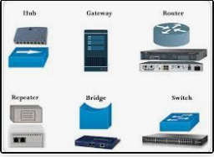
network
Network – Multiple computers are connected to share resources
Classification of Network
Local Area Network
Metropolitan Area Network
Wide Area Network
Local Area Network (LAN)
- Connects network devices
Fig: Local Area Network

Slide 11
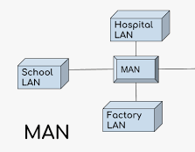
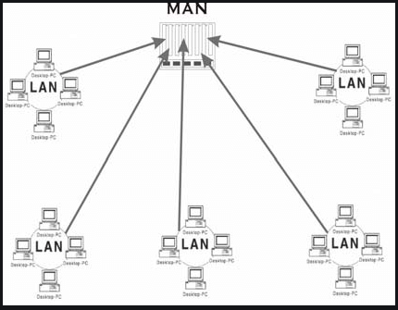
Classification of network
Metropolitan Area Network (MAN)
- Covers large geographical area than LAN
- Connects several building in a city/town
- Fiber optic cable
Fig : Metropolitan Area Network

Slide 12
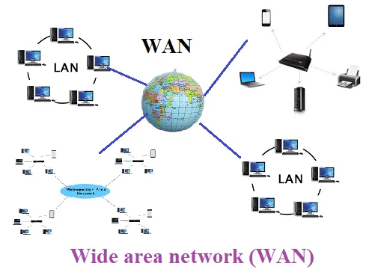
Classification of network
Wide Area of Network (WAN)
- Connects two or more geographic area
- Carry data over greater distances
- Covers wide area than MAN

Slide 13
Advantage and Disadvantage of a computer
Advantage
- Easy processing
- Saves time
- Errors are minimized
- Communication is easier
- High storage capacity
Disadvantage
- Perform operations based on the
instructions given on it.
- Need well defined instructions

Slide 14
Application of a computer
Education - computer based presentation
Publishing - for publishing book, magazines
Agricultural - for analyzing data
Home - preparing documents, excel
Entertainment - playing games

Slide 15
Programming Languages
A computer program is a sequence of instructions written using a computer programming language to perform a specified task by the computer
The act of writing computer programs is called computer programming. The computer programming language is the language to be used to write a computer program.
- Assembly
- C
- C++
- Java
- Python
- PHP

Slide 16
Programming Languages
Programming languages can be classified into
Low level language (0’s and 1’s)
- Machine Language
- 0’s and 1’s
- difficult task for the programmer
- maintenance is high
- Assembly Language
- mov, sub, add
- Easy to write and understand
- Easy to maintain
- Need translator (Assembler)
High level language
- Closer to human language
- Need Translator (Compiler)

Slide 17
Difference between machine language and Assembly language
Machine Level Language | Assembly Language
It cannot be easily understand by human | It is easy to read, write and maintain
It is written in binary digits | It is written in simple english
It does not require any translator | Need Translator

Slide 18
Difference between low level language and high level language
Low Level Language | High Level Language
Machine friendly language | User friendly language
Represented in 0’s and 1’s | Represented in simple english
Takes more time to execute | Executes at a faster pace
Machine code cannot run on all machines. So it is not a portable language | It can run on all the machines. Portable
Debugging and maintenance is not easier | Debugging and maintenance is easy

Slide 19
Problem Solving Technique
PROBLEM SOLVING
Problem solving is the systematic approach to define the problem and creating number of solutions.
The problem solving process starts with the problem specifications and ends with a Correct program.
PROBLEM SOLVING TECHNIQUES
Problem solving technique is a set of techniques that helps in providing logic for solving a problem.
Problem solving can be expressed in the form of
1. Algorithms.
2. Flowcharts.
3. Pseudo codes.
4. programs

